Slide 1
Core Methods in Educational Data Mining
EDUC6191 Fall 2022

Slide 2
Finishing up last class

Slide 3
Epistemic Network Analysis
Is anyone here familiar with ENA?
What is it?

Slide 4
Epistemic Network Analysis
Is anyone here familiar with ENA?
What is it?
Studying relationships between elements in coded data

Slide 5
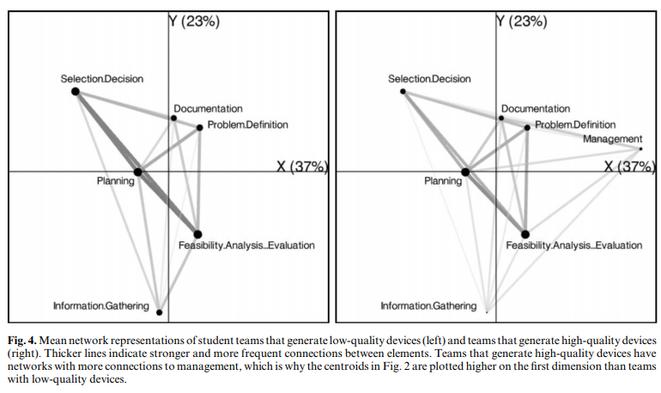
Studying Process of Successful and Unsuccessful Teams (Arastoopour et al., 2016)

Slide 6
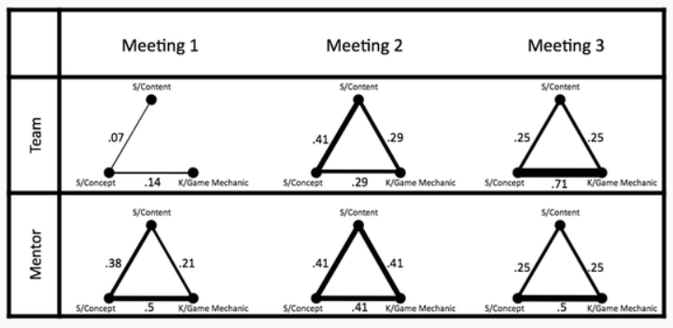
Studying connections between topics in meetings over time (Nash & Shaffer, 2013)

Slide 7
Questions? Comments?

Slide 8
Has anyone here…
… conducted an ENA?
If so, please tell us about it

Slide 9

To learn more about ENA
EDUC5100 Quantitative Ethnography

Slide 10
Basic Assignment: SNA
Any questions? Comments?

Slide 11
Knowledge Inference and BKT

Slide 12
What is the Goal of Knowledge Inference?

Slide 13
What is the Goal of Knowledge Inference?
Measuring what a student knows at a specific time
Measuring what relevant knowledge components a student knows at a specific time

Slide 14
Why is it useful to measure student knowledge?

Slide 15
Key assumptions of BKT
Assess a student’s knowledge of skill/KC X
Based on a sequence of items that are scored between 0 and 1
Classically 0 or 1, but there are variants that relax this
Where each item corresponds to a single skill
Where the student can learn on each item, due to help, feedback, scaffolding, etc.

Slide 16
Key assumptions of BKT
Each skill has four parameters
From these parameters, and the pattern of successes and failures the student has had on each relevant skill so far
We can compute
Latent knowledge P(Ln)
The probability P(CORR) that the learner will get the item correct

Slide 17
Key assumptions of BKT
Two-state learning model
Each skill is either learned or unlearned
In problem-solving, the student can learn a skill at each opportunity to apply the skill
A student does not forget a skill, once he or she knows it

Slide 18
Model Performance Assumptions
If the student knows a skill, there is still some chance the student will slip and make a mistake.
If the student does not know a skill, there is still some chance the student will guess correctly.

Slide 19
Comments? Questions?

Slide 20
Classical BKT
Not learned
p(T)
Learned
p(L₀)
p(G)
1-p(S)
correct
correct
Two Learning Parameters
p(L₀) Probability the skill is already known before the first opportunity to use the skill in problem solving.
p(T) Probability the skill will be learned at each opportunity to use the skill.
Two Performance Parameters
p(G) Probability the student will guess correctly if the skill is not known.
p(S) Probability the student will slip (make a mistake) if the skill is known.

Slide 21
Comments? Questions?

Slide 22
Parameter Fitting
Picking the parameters that best predict performance on next attempt
Any questions or comments on this?

Slide 23
Overparameterization
BKT is thought to be overparameterized (Beck et al., 2008)
Which means there are multiple sets of parameters that can fit any data

Slide 24
Degenerate Space (Pardos et al., 2010)

Slide 25
Parameter Constraints Proposed
Beck
P(G)+P(S)<1.0
Baker, Corbett, & Aleven (2008):
P(G)<0.5, P(S)<0.5
Corbett & Anderson (1995):
P(G)<0.3, P(S)<0.1
Your thoughts?

Slide 26
Does it matter what algorithm you use to select parameters?
EM better than CGD
Chang et al., 2006 ΔA’= 0.05
CGD better than EM
Baker et al., 2008 ΔA’= 0.01
EM better than BF
Pavlik et al., 2009 ΔA’= 0.003, ΔA’= 0.01
Gong et al., 2010 ΔA’= 0.005
Pardos et al., 2011 Δ RMSE= 0.005
Gowda et al., 2011 ΔA’= 0.02
BF better than EM
Pavlik et al., 2009 ΔA’= 0.01, ΔA’= 0.005
Baker et al., 2011 ΔA’= 0.001
BF better than CGD
Baker et al., 2010 ΔA’= 0.02

Slide 27
Are these the same thing?
Predicting performance on next attempt
Inferring latent knowledge

Slide 28
What are some alternate ways to assess
Whether a model is successful at inferring latent knowledge

Slide 29
What are some alternate ways to assess
Whether a model is successful at inferring latent knowledge
Why aren’t those approaches used more often?

Slide 30
Questions? Comments?

Slide 31
What are some possible uses of BKT?
Both the P(Ln) estimates
And the other parameters it produces

Slide 32
BKT: Extended uses

Slide 33
BKT: Extended uses
Conditionalizing P(T)
Does help help? (Beck et al., 2008)
Which content is most effective? (Baker et al., 2018)

Slide 34
BKT: Extended uses
Moment-by-moment learning estimation (calculating P(T) in specific step)
Which moment-by-moment learning curves are associated with more robust learning? (Baker et al., 2013)
What behaviors predict “eureka” moments (Moore et al., 2015)
Which types of content are associated with more learning? (Slater et al., 2016)

Slide 35
BKT: Extended uses
Detecting carelessness (contextual slip) (calculating P(S) in specific step)
Predicts test score (Pardos et al., 2014), college enrollment (San Pedro et al., 2013), job several years later (Almeda & Baker, 2020)

Slide 36
BKT: Extended uses
Transfer assessment (adding P(T) from other skills)
Used to study relationship between skills (Sao Pedro et al., 2014)
Including in graduate students learning research skills across several years (Kang et al., 2022)

Slide 37
Last Comments? Questions?

Slide 38
Next Classes
October 20
Association Rule Mining and Sequential Pattern Mining (Valdemar)
BA4 due
October 27
Logistic Knowledge Tracing
BA5 due
November 3
Text Mining (Valdemar)
BA6 due

Slide 39
The End

